Slide 1
Tsugi At Five Years Old An Update
Dr. Charles Russell Severance
Clinical Professor, University of Michigan School of Information
www.tsugi.org/django_sakai.txt

Slide 2
What is Tsugi?
Learning Application Development Framework
Learning App Store
Standards Compliance / LMS Integration Libraries
Hosted services
Koseu
Learning Object Repository
MOOC Hosting Platform

Slide 3
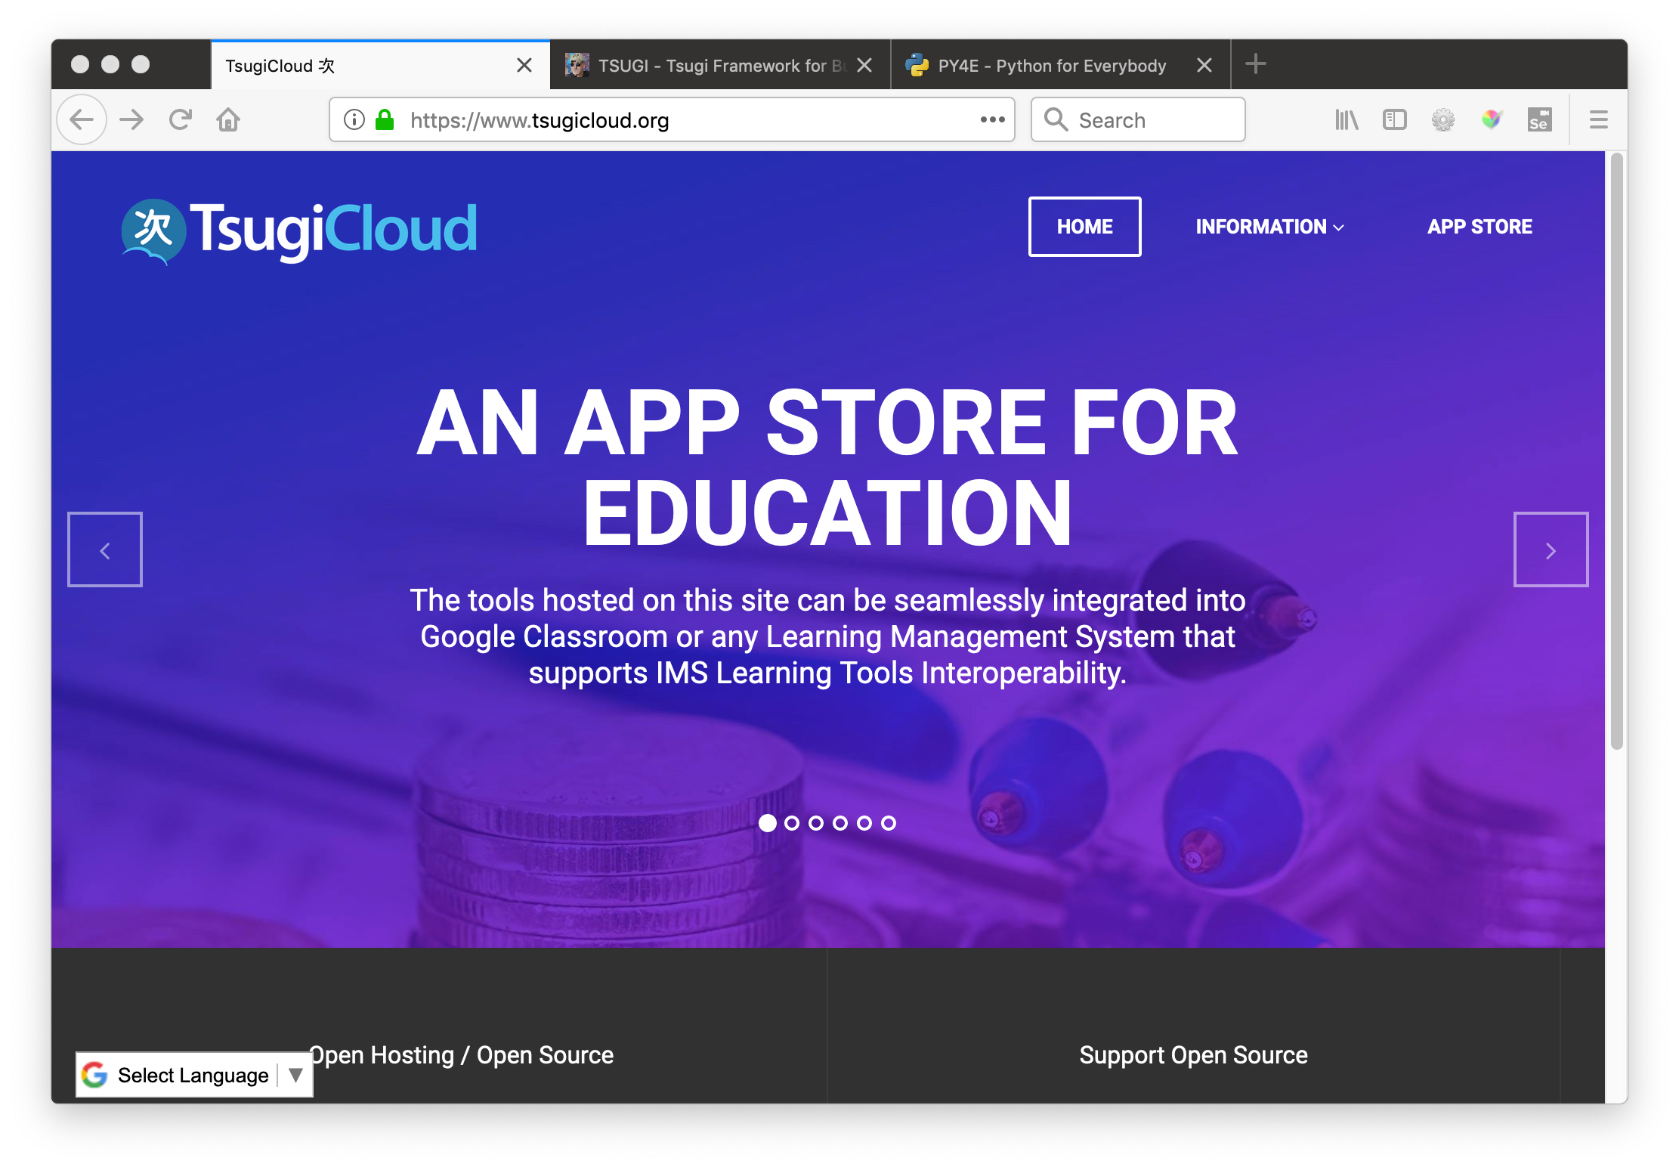

Slide 4
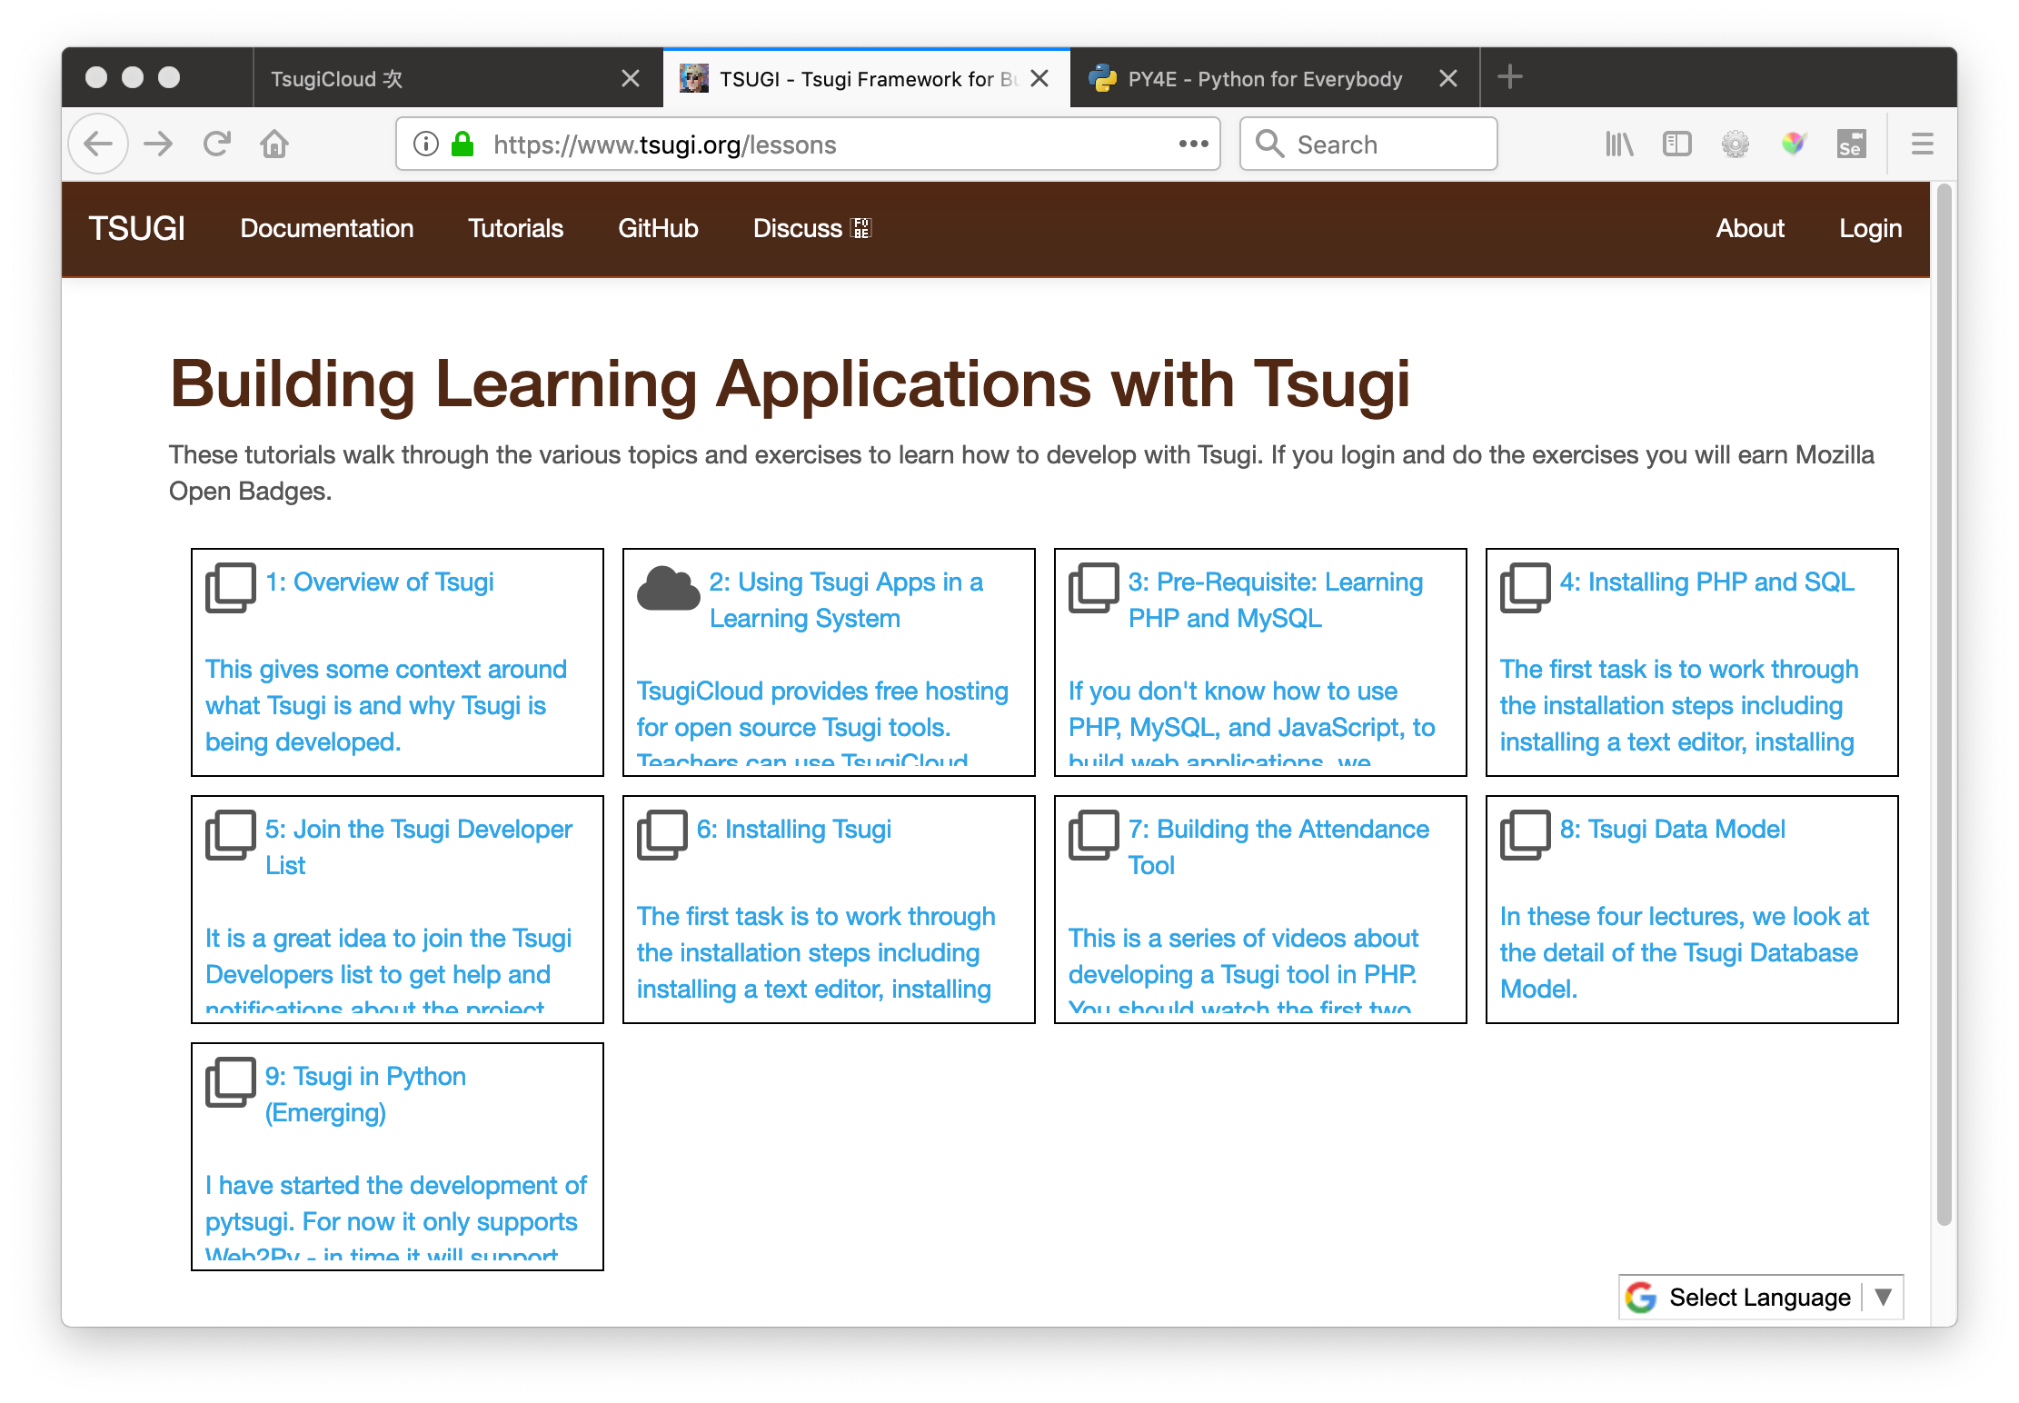

Slide 5
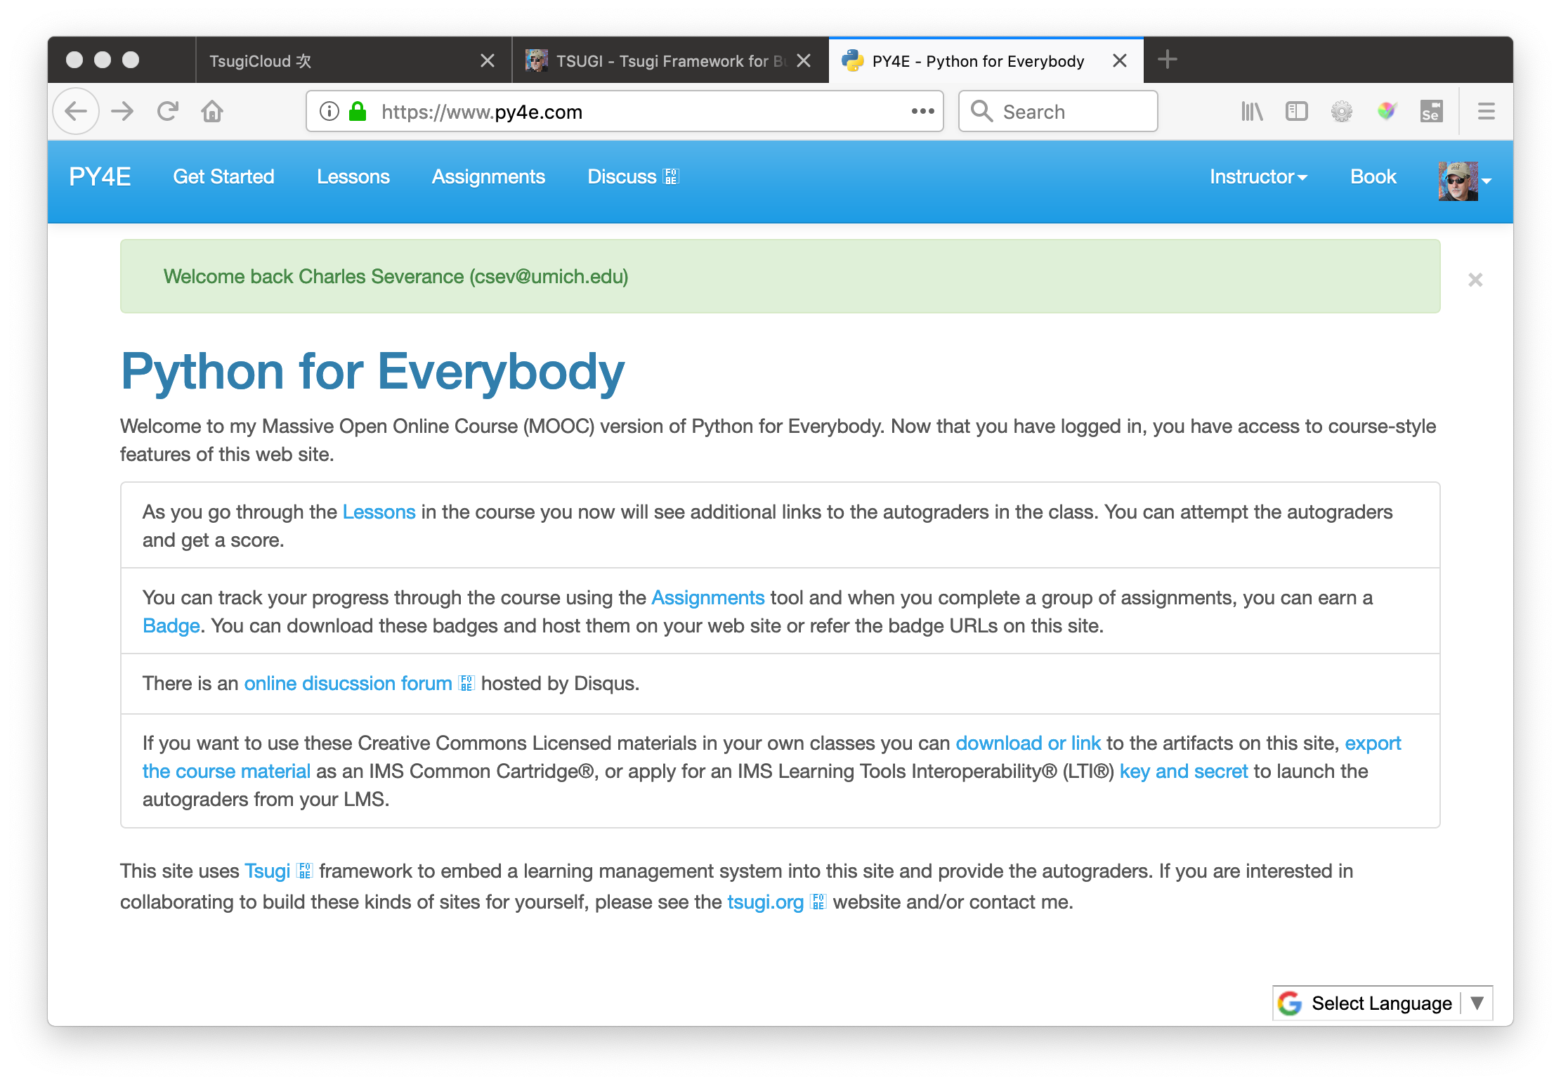

Slide 6
Outline
Emerging Django Tsugi
Tsugi PHP Status
LTI Advantage
Tsugi as Middleware
Tsugi Python
Django Tsugi

Slide 7




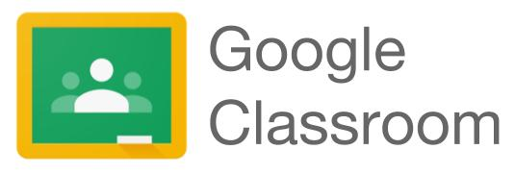
LTI 1.0
LTI 1.1
LTI 2.0
LTI Advantage
Google Classroom
Tsugi
JWT Launch
RPC API

Slide 8
Embedded Workshop – Tsugi Django
Instructions - https://www.tsugi.org/django_sakai.txt
Make an account on www.pythonanywhere.com
Set up virtual environment
Pull down https://github.com/tsugiproject/djtest
Get it running in PythonAnywhere
Link it into test.tsugicloud.com
Install it into https://dev1.sakaicloud.com
Launch as student – send a grade from Django to Sakai

Slide 9
Django Tsugi –Educational Apps for Everyone
from django.shortcuts import render
from django.views import View
from django_tsugi.mixins import TsugiMixin
class GradeView(TsugiMixin, View):
def get(self, request) :
context = {'tsugi': request.tsugi}
return render(request, 'grade/main.html', context)
def post(self, request) :
grade = float(request.POST.get('grade'))
comment = request.POST.get('comment')
retval = request.tsugi.result.gradeSend(grade, comment)
context = {'tsugi': request.tsugi, 'retval' : retval}
return render(request, 'grade/done.html', context)
https://github.com/tsugiproject/djtest

Slide 10



LTI 1.0
LTI 1.1
LTI 2.0
LTI Advantage
Google Classroom
Tsugi
JWT Launch
RPC API

Slide 11
The World of Tsugi PHP
Web Site - https://github.com/tsugiproject/tsugi-org
Tsugi UI - https://github.com/tsugiproject/tsugi
Tsugi PHP Library - https://github.com/tsugiproject/tsugi-php
Tsugi Static Assets - https://github.com/tsugiproject/tsugi-static
Koseu – LMS / Learning Object Repository
Python for Everybody - https://github.com/csev/py4e
Web Applications for Everybody - https://github.com/csev/wa4e

Slide 12
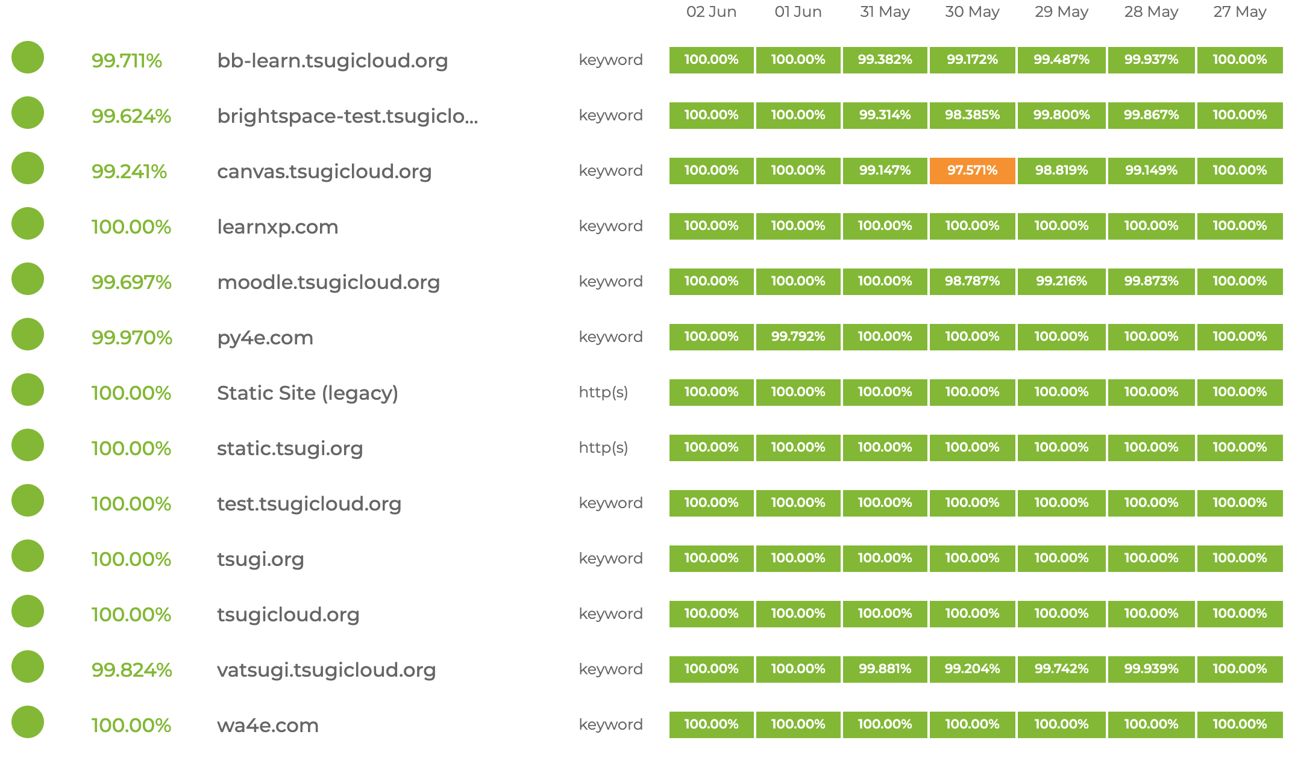
Tsugi Servers – status.tsugi.org

Slide 13
Deprecated and New in 2019
New / Emergent
https://github.com/tsugiproject/django-tsugi
Deprecated - High level Tsugi libraries:
https://github.com/tsugicontrib/tsugi-java
https://github.com/tsugicontrib/tsugi-node
https://github.com/tsugicontrib/pytsugi (may be reincarnated)
Not deprecated – low level standards libraries
https://github.com/tsugiproject/tsugi-util (Java – Updated to LTI Advantage)
https://github.com/tsugiproject/tsugi-node-lti (No plans for LTI Advantage)

Slide 14
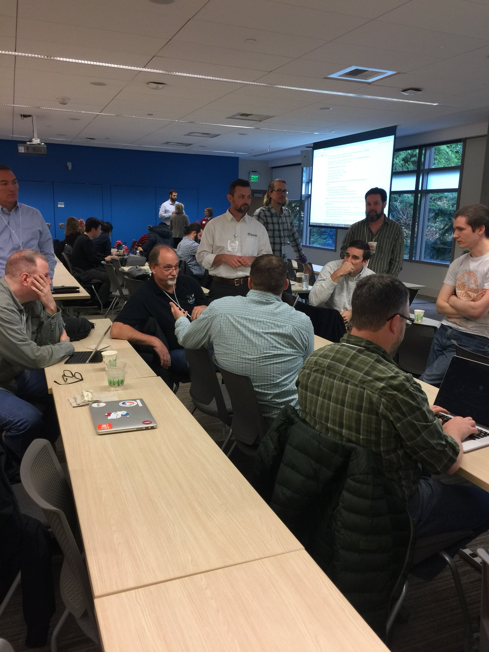
LTI Advantage
Rich scope:
Launch, Install, Membership, Gradebook
OAuth 2.0 / Java Web Tokens
Rapid Uptake:
Sakai, Canvas, Blackboard, Moodle
Tsugi, Cengage, Turnitin, VitalSource, McGraw-Hill
This will be disruptive

Slide 15
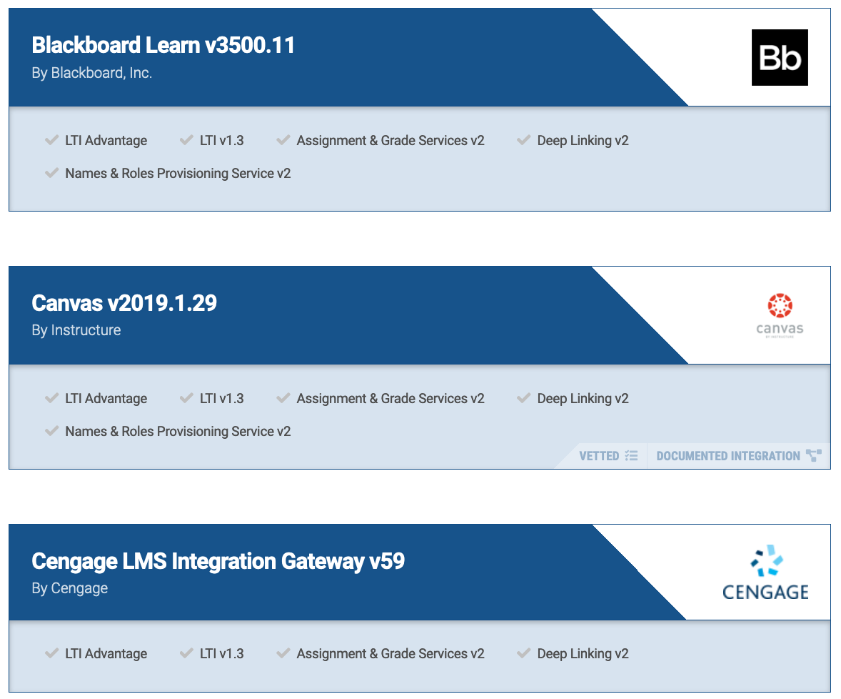
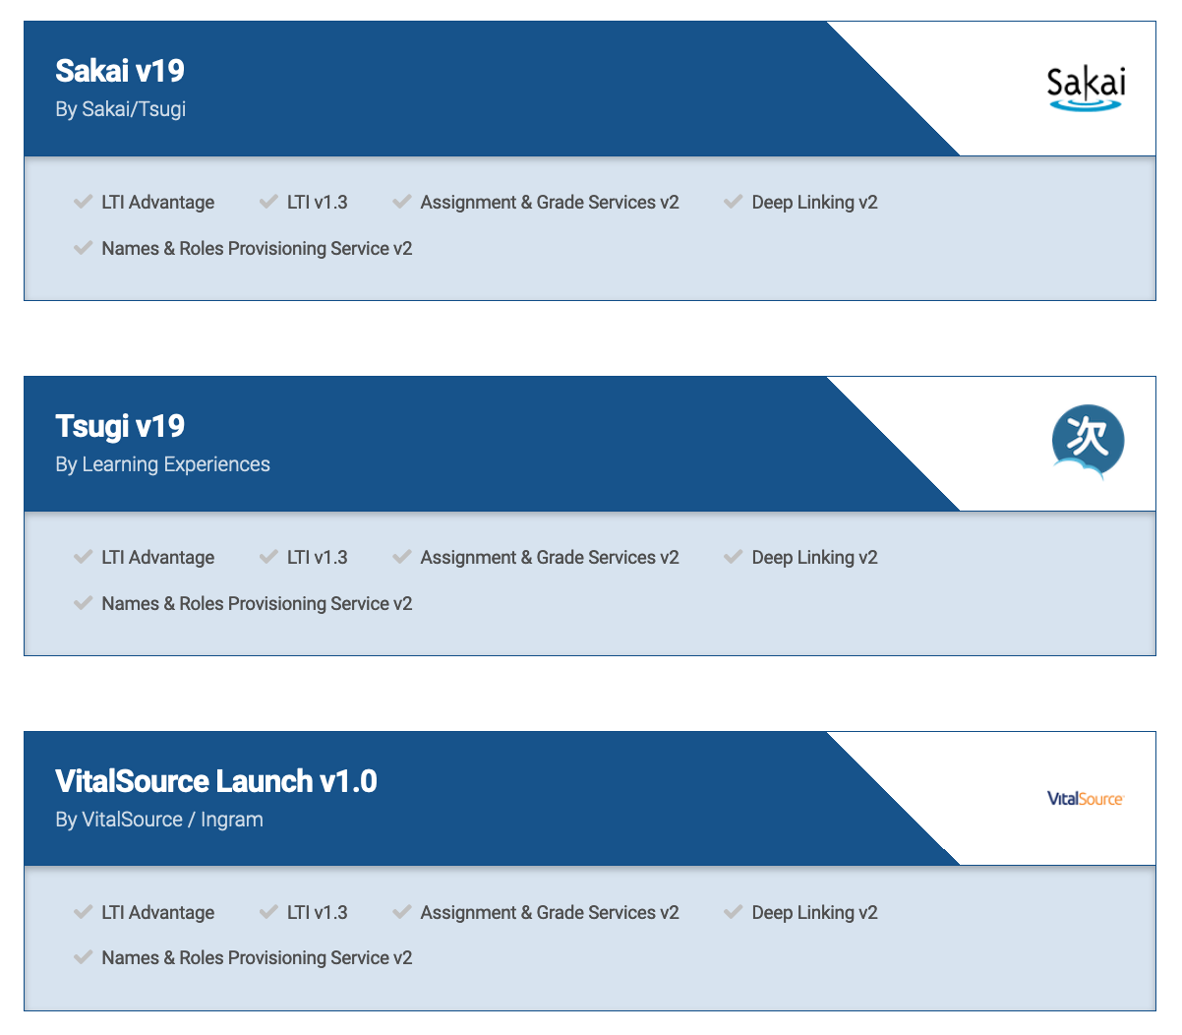
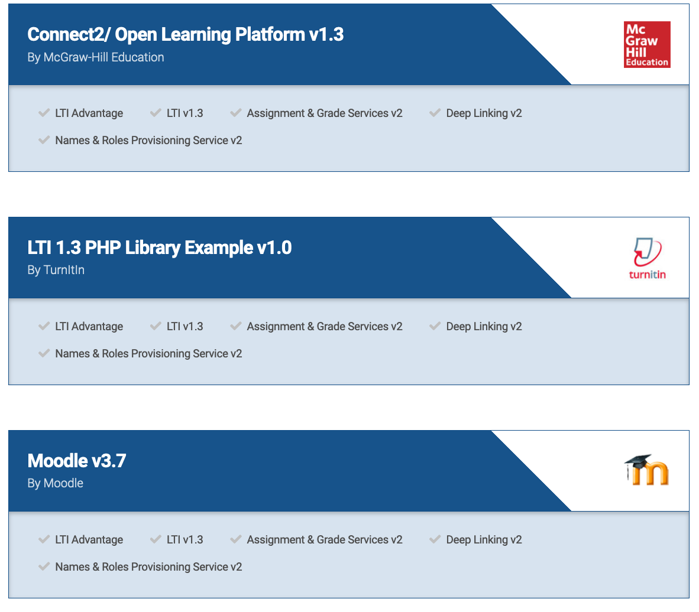

Slide 16


Tsugi in AWS
C
l
o
u
d
f
l
a
r
e
Amazon
F
I
r
e
w
a
l
l
Terraform / Ansible / Consul / Vault
NginX
EC2/ASG
Aurora
EC2/ASG
EFS
…
EC2/ASG
ElastiCache

Slide 17
Tsugi Servers for LTI Advantage Testing
End point for LTI Advantage Interoperability Testing
Facilitate Django Tsugi demos at Summer LMS conferences
Also – https://dev1.sakaicloud.com/ for tool vendors to test/demo their LTI Advantage tools

Slide 18
LTI 1.x Proxy Use Case
LTI 1.0
LTI 1.1
LTI 2.0
LTI Advantage
Google Classroom
Legacy LTI 1.1
Tool that
does not want
to implement
LTI Advantage
LTI 1.1
Launch
LTI 1.1 Basic
Outcome

Slide 19
Tsugi Caliper LRS
LTI 1.0
LTI 1.1
LTI 2.0
LTI Advantage
Google Classroom
Analytics
Visualization
Caliper Data
LTI Launches
Caliper Data
LTI Launch
LTI 1.1 Basic
Outcome
Web Services
MySQL
Postgres

Slide 20
Taking Stock
Tsugi PHP approaching a 1.0 release
Remove LTI 2.0 support
Improve Proxy(Django) / Middleware use cases
Tsugi LRS / Caliper will be starting Summer 2019
Solid / scalable commercial hosting
This code is kind of like Apache 1.0 for Learning Applications

Slide 21
A Bit of Pivot …

Slide 22
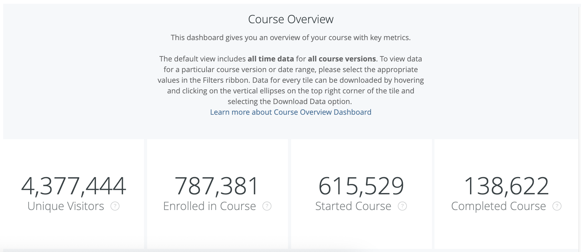
Python for Everybody: Coursera

Slide 23
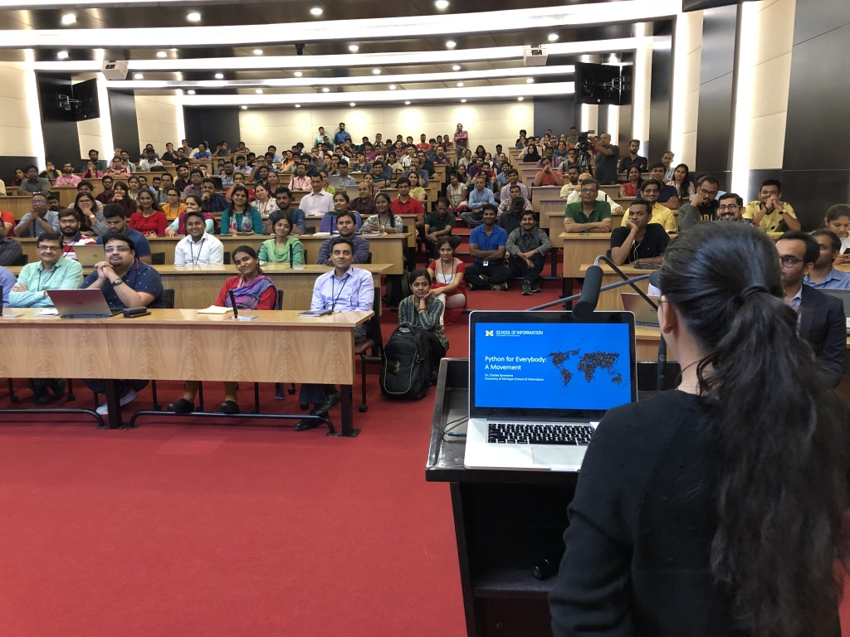

Slide 24
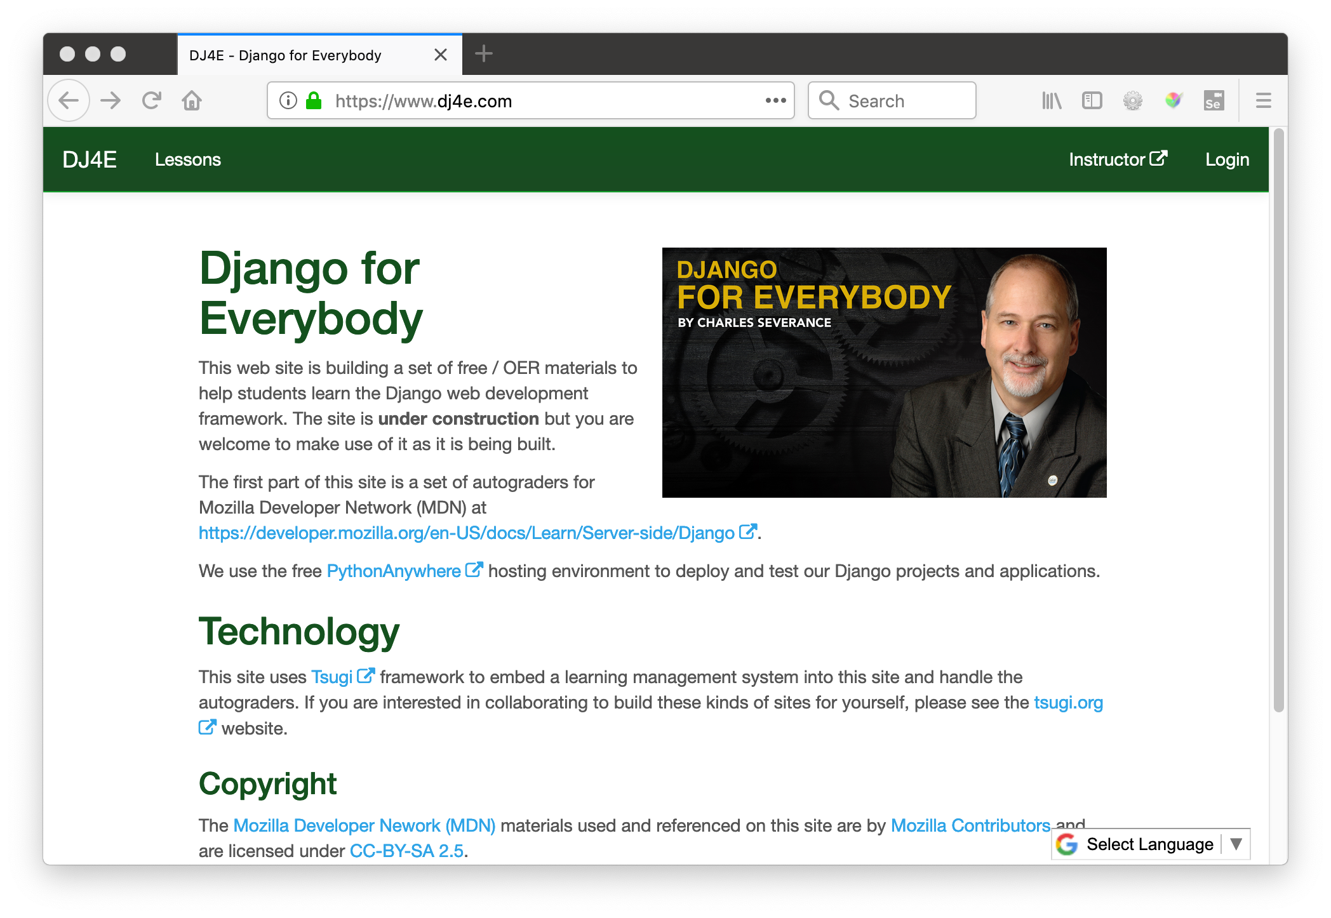

Slide 25
If I were building an open source LMS today..
It would be written in Python / Django
It will use IMS LTI Advantage as its internal architecture
APIs will be OAuth 2.0 / JWT based
It will elegant and easy to understand / modify
It would cover the entire scope of Canvas/Sakai and OpenEdX – one LMS for on-campus and online
It would be an "App Store" – Every tool will be available as an "App"
It will be a "Learning Object Repository" – All content will be exportable

Slide 26
LTI 1.0
LTI 1.1
LTI Advantage
Google Classroom
MySQL

Slide 27
Tsugi 2.0??? 2021??
LTI 1.0
LTI 1.1
LTI Advantage
Google Classroom
Postgres

Slide 28
LTI 1.0
LTI 1.1
LTI Advantage
Google Classroom
Tsugi
JWT Launch
RPC API

Slide 29
LTI 1.0
LTI 1.1
LTI Advantage
Google Classroom
Legacy LTI 1.1
tools that
do not want
to implement
LTI Advantage
LTI 1.1
Launch
LTI 1.1 Basic
Outcome

Slide 30
Tsugi PHP will be around a long time….
Like Apache 1.x – a known commodity
It will slow down and focus on performance, reliability, and documentation, etc…
All my own production / MOOCs depend heavily on the PHP Tsugi – any transition cannot break anything
Django / Python rewrite will be very much in the background – it might wander / explore use cases a bit

Slide 31
Summary
Short Term
Tsugi PHP and Koseu are adoptable and scalable
Better documentation / automated QA / tutorials
Medium Term
Tsugi Django will be the main message – Summer 2019
Tsugi Caliper Record Store will have value to both Tsugi and Sakai as well as gain experience with Django + Postgres
Long Term
Exploring the "Last LMS" ???
Exploring alternate forms of the LMS made possible with LTI Advantage

